Slide 1










Software Technologies
Course Overview
Software Technologies
SoftUni Team
Technical Trainers
Software University
http://softuni.bg

Slide 2



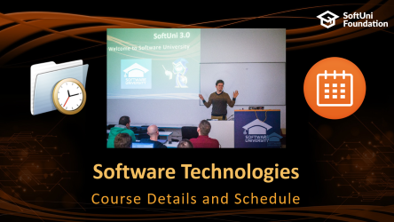
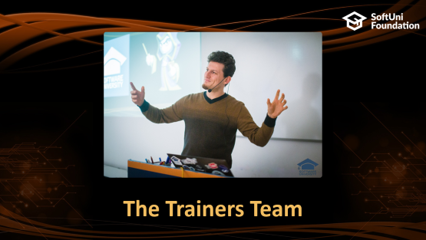



Table of Contents

Slide 3
Have a Question?
sli.do #tech-softuni

Slide 4



Software Technologies
Software Technologies
Course Objectives & Program

Slide 5

Course Objectives
The "Software Technologies" course provides the first steps in 5 technologies:
Basics of HTML & CSS
Web development with JavaScript
Web development with PHP
Web development with Java
Web development with C#

Slide 6

Warning: This Course is at Very Basic Level
The course is very introductory
It will NOT teach you HTML, CSS, JavaScript, PHP, MySQL, .NET, Entity Framework, ASP.NET MVC, Java, Hibernate and Spring MVC
It will make you familiar with these technologies
You get an idea how these technologies work
You will touch all of them in 2 months
You will create a simple blog system

Slide 7

Course Topics
Part 0 – HTML & CSS
Basics of HTML & CSS, Creating the Blog Design
Part I – JavaScript, Express and MySql
ES6, Node.js, Express.js, MySql
Creating a blog with Express.js and MySql
Part II – PHP, Symfony and MySql
XAMPP, PHP 7, MySQL, Doctrine, Symfony
Creating a blog with Symfony and MySQL

Slide 8




Course Topics (2)
Part III – Java Web Development
Java 8, Hibernate, Spring MVC, MySQL
Creating a blog with Spring MVC and Hibernate
Part IV – C# Web Development
C# 7, Entity Framework, ASP.NET MVC, MySQL
Creating a blog with ASP.NET MVC and EF

Slide 9
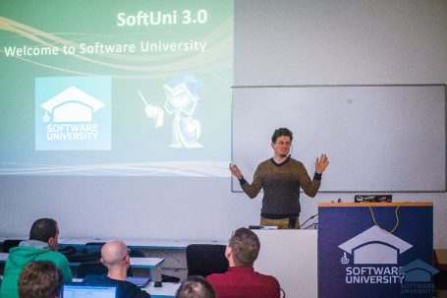


Software Technologies
Course Details and Schedule

Slide 10
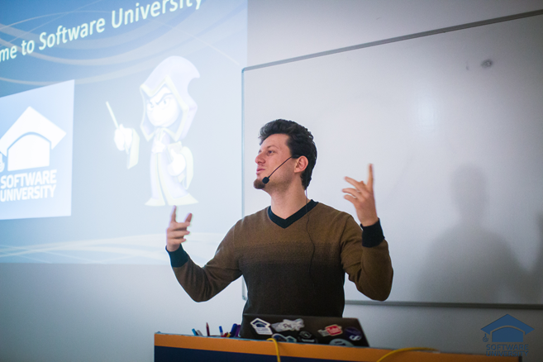
Training Duration and Schedule
Lessons: ~ 70 hours (onsite + YouTube videos)
Practical exercises (in class): ~ 110 hours
Practical Exam: 4 hours
Allocation
Timeframe: March – April 2018
Regular Exam: 22 April 2018

Slide 11
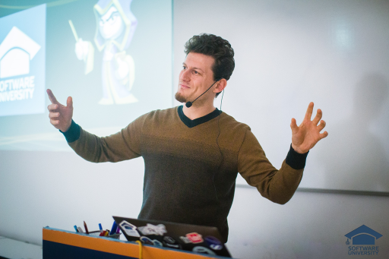
The Trainers Team

Slide 12
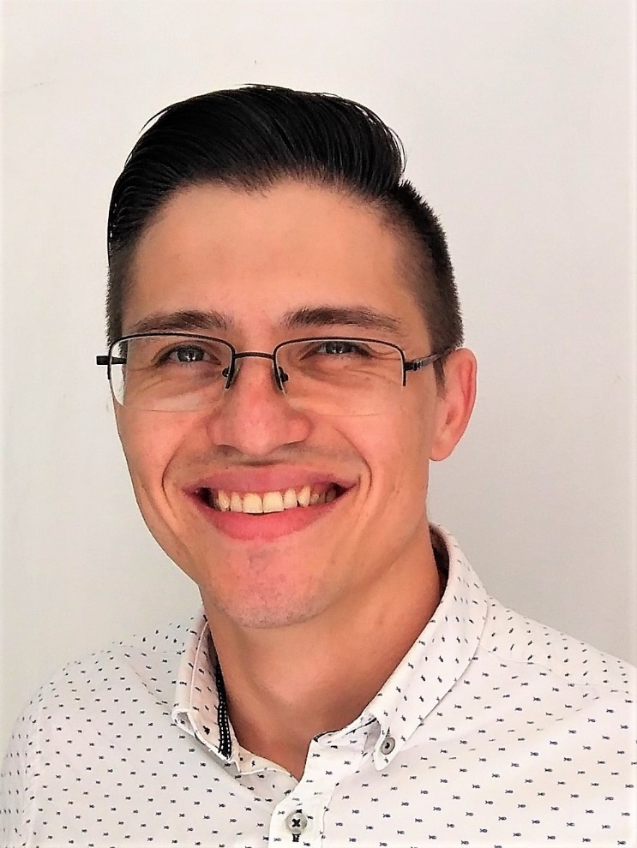
Trainers Team
Alen Paunov
Technical Trainer @ SoftUni
Passionate about C# and GameDevelopment
Interested in Blockchain and Quantum Technologies
Top performing student @ SoftUni

Slide 13
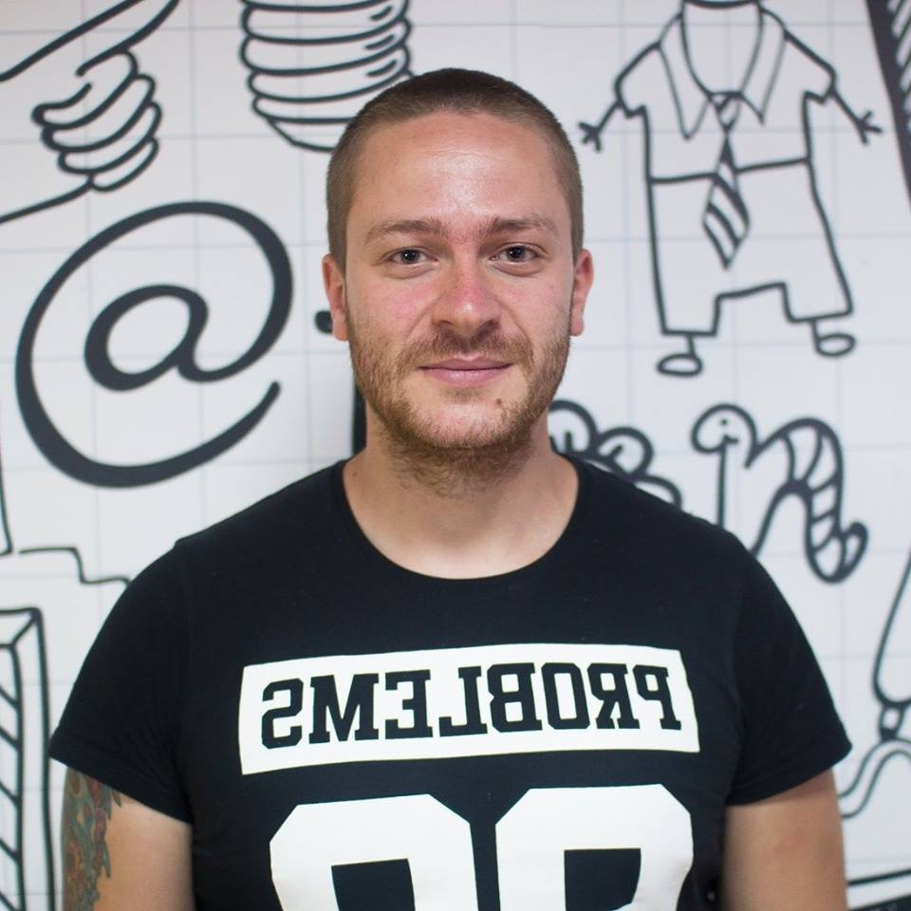
Trainers Team
Ivaylo Kenov
Various job titles at the same time:
Mathematical competitions champion
Full Stack Technical Trainer
Senior Software Developer
Solution Architect & Technical Lead
One-man army @ My Tested ASP.NET
Contacts:
https://github.com/ivaylokenov
https://facebook.com/ivaylo.kenov
https://linkedin.com/in/kenov

Slide 14

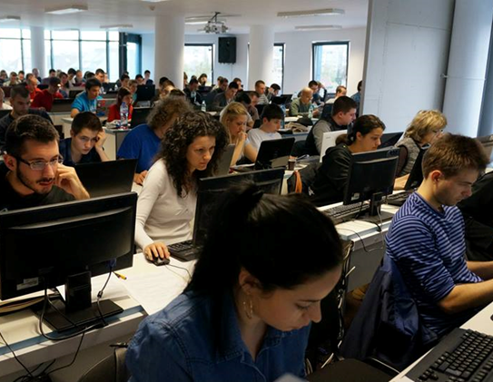
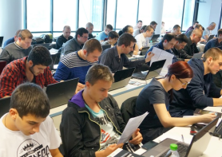
Software Technologies
Evaluation Criteria

Slide 15



Scoring System for the Course
Practical exam – 90%
Homework (judge & uploads) – 10%
Forum activity – bonus up to 10%
Presence in class – 5% bonus

Slide 16


Homework Assignments
Your homework is mainly work in class!
Lesson days → live coding workshop
Exercise days → exercises only
How to submit your homework?
Some submitted in the judge system
Others uploaded in the course Web site
Homework assignments are due in 1 week

Slide 17
Practical Exam
Create an application which supports basic CRUD operations
Examples: “TODO List” (view / add / delete items), “Poll System” (vote, list / delete votes), “Bookmarks” (add / delete bookmarks)
Write the app 4 times: in PHP, JS, C# and Java
Exam time: 4 hours
Exam check-up: 2-3 hours (immediately after the exam)
Trainers / assistants check your solution on your laptop
You will NOT be allowed to modify your code after the exam ends

Slide 18



Learn to Search in Internet & Find Solutions!
The course assignments require to search in Internet
This is an important part of the learning process
Some exercises intentionally have no hints
Learn to find solutions!
Software development includes everyday searching and learning
No excuses, just learn to study!
Developers learn new technologies, tools, languages every day!

Slide 19










Resources
What We Need Additionally?

Slide 20

Course Web Site & Forums
The Software University official web site:
Register for the "Software University Forum":
Discuss the course exercises with your colleagues
Find solutions for all course exercises
Share source code / discuss ideas / help each other
https://softuni.bg/courses/software-technologies
https://softuni.bg/forum/categories/45

Slide 21

The Software Technologies Slides and Videos
All lecture slides, videos, homework assignments, projects and other resources are open content, available for free
Visit the course web site to access the course resources

Slide 22




Recommended Software
PhpStorm – https://jetbrains.com/phpstorm/ – for PHP
WebStorm – https://jetbrains.com/webstorm/ – for JS
IntelliJ Idea – https://www.jetbrains.com/idea/ – for Java
Visual Studio – https://www.visualstudio.com – for .NET

Slide 23







Software Technologies – Course Overview
https://softuni.bg/courses/software-technologies

Slide 24
License
This course (slides, examples, demos, videos, homework, etc.) is licensed under the "Creative Commons Attribution-NonCommercial-ShareAlike 4.0 International" license

Slide 25





Trainings @ Software University (SoftUni)
Software University – High-Quality Education, Profession and Job for Software Developers
softuni.bg
Software University Foundation
http://softuni.foundation/
Software University @ Facebook
facebook.com/SoftwareUniversity
Software University Forums
forum.softuni.bg

